Slide 1
Battle Tanks/Turtles A simplified visual representation of what is going when you program the CPU

Slide 2
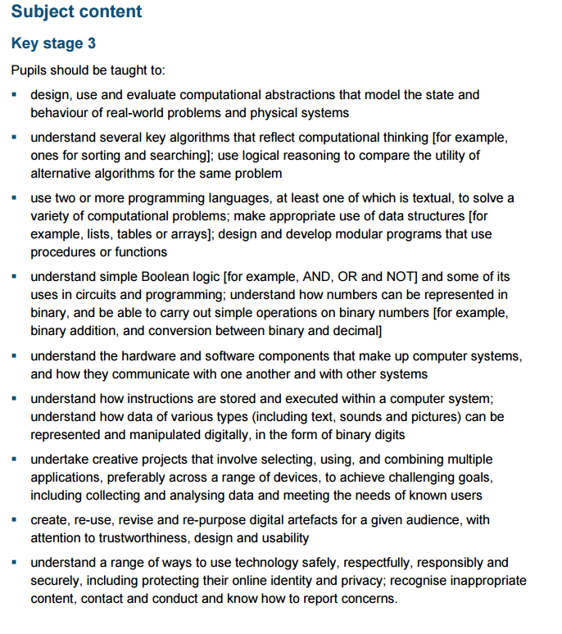
National Curriculum Context - KS3

Slide 3
National Curriculum Context - KS3
Understand how instructions are stored and executed within a computer system.
Processors have instruction sets and they relate to low-level instructions carried out by a computer
Practical experience of a low-level programming language.
Concepts behind the fetch-execute cycle

Slide 4
CPU Battle Tanks
Pete Dring
https://pddring.github.io/cpu-battle-tank/
Attempts to introduce low level programming in an engaging context
First level allows the use the screen based controls
Quite a steep learning curve
Uses LMC instruction set

Slide 5
CPU Battle turtles
A remix of Pete Dring’s original
http://uvhs-comp.github.io/cpu-battle-tank/
Attempts to make the learning curve shallower
Supporting documentation to help explain the concepts and interface to non-specialists and specialists
Some lesson ideas/resources
Focus on
Accumulator
LDA / OUT / HLT / DAT
Output channel / device

Slide 6
Paper based intro
Output: movement, steering
Instructions stored in memory, FEC
Input: radar, collision detection
Output: turret, fire

Slide 7


Output Channels
Channel 1
Movement
Channel 3
Aim Gun
Channel 1
Movement
Channel 1
Movement
Channel 4
Fire Gun
Channel 2
Steering
Channel 1
Movement
Channel 1
Movement
Accumulator
This is where the tank gets its instructions from

Slide 8
Moving the Tank/Turtle
To achieve this you will have to give an instruction to Output Channel 1 which controls movement
Channel 1 can accept 2 different instructions
0 - Moves the Tank Forwards
1 - Moves The Tank Backwards

Slide 9
Moving the Tank/Turtle Forward
To achieve this the correct number for the direction (in this case 0) must be loaded into the Accumulator Register
The contents of this register then need to be output to the correct Output Channel - in this case channel 1

Slide 10
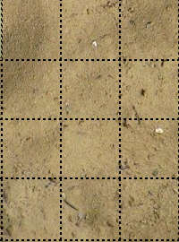
// Making the Tank Move
LDA Forward
OUT 1
// Data Labels
Forward DAT 0
Backward DAT 1
North DAT 0
East DAT 2
South DAT 4
West DAT 6
Accumulator
Channel 1
Movement
Channel 2
Steering
Channel 1
Movement
Channel 1
Movement
Channel 3
Aim Gun
Channel 4
Fire Gun
Channel 1
Movement
Channel 1
Movement

Slide 11
// Making the Tank Move
LDA Forward
OUT 1
// Data Labels
Forward DAT 0
Backward DAT 1
North DAT 0
East DAT 2
South DAT 4
West DAT 6
Accumulator
Channel 1
Movement
Channel 2
Steering
Channel 1
Movement
Channel 1
Movement
Channel 3
Aim Gun
Channel 4
Fire Gun
Channel 1
Movement
Channel 1
Movement

Slide 12
// Making the Tank Move
LDA Forward
OUT 1
// Data Labels
Forward DAT 0
Backward DAT 1
North DAT 0
East DAT 2
South DAT 4
West DAT 6
Accumulator
0
Channel 1
Movement
Channel 2
Steering
Channel 1
Movement
Channel 1
Movement
Channel 3
Aim Gun
Channel 4
Fire Gun
Channel 1
Movement
Channel 1
Movement

Slide 13
// Making the Tank Move
LDA Forward
OUT 1
// Data Labels
Forward DAT 0
Backward DAT 1
North DAT 0
East DAT 2
South DAT 4
West DAT 6
Accumulator
0
Channel 1
Movement
Channel 2
Steering
01
Channel 1
Movement
Channel 3
Aim Gun
Channel 4
Fire Gun
Channel 1
Movement
Channel 1
Movement

Slide 14
Moving the Tank Forward 2 spaces

Slide 15
// Making the Tank Move
LDA Forward
OUT 1
OUT 1
// Data Labels
Forward DAT 0
Backward DAT 1
North DAT 0
East DAT 2
South DAT 4
West DAT 6
Accumulator
Channel 1
Movement
Channel 2
Steering
Channel 1
Movement
Channel 1
Movement
Channel 3
Aim Gun
Channel 4
Fire Gun
Channel 1
Movement
Channel 1
Movement

Slide 16
// Making the Tank Move
LDA Forward
OUT 1
OUT 1
// Data Labels
Forward DAT 0
Backward DAT 1
North DAT 0
East DAT 2
South DAT 4
West DAT 6
Accumulator
Channel 1
Movement
Channel 2
Steering
Channel 1
Movement
Channel 1
Movement
Channel 3
Aim Gun
Channel 4
Fire Gun
Channel 1
Movement
Channel 1
Movement

Slide 17
// Making the Tank Move
LDA Forward
OUT 1
OUT 1
// Data Labels
Forward DAT 0
Backward DAT 1
North DAT 0
East DAT 2
South DAT 4
West DAT 6
Accumulator
0
Channel 1
Movement
Channel 2
Steering
Channel 1
Movement
Channel 1
Movement
Channel 3
Aim Gun
Channel 4
Fire Gun
Channel 1
Movement
Channel 1
Movement

Slide 18
// Making the Tank Move
LDA Forward
OUT 1
OUT 1
// Data Labels
Forward DAT 0
Backward DAT 1
North DAT 0
East DAT 2
South DAT 4
West DAT 6
Accumulator
0
Channel 1
Movement
Channel 2
Steering
01
Channel 1
Movement
Channel 3
Aim Gun
Channel 4
Fire Gun
Channel 1
Movement
Channel 1
Movement

Slide 19
// Making the Tank Move
LDA Forward
OUT 1
OUT 1
// Data Labels
Forward DAT 0
Backward DAT 1
North DAT 0
East DAT 2
South DAT 4
West DAT 6
Accumulator
0
Channel 1
Movement
Channel 2
Steering
01
Channel 1
Movement
Channel 3
Aim Gun
Channel 4
Fire Gun
Channel 1
Movement
Channel 1
Movement

Slide 20
Moving the Tank Forward 2 spaces turning right and moving forward 2 more spaces

Slide 21
// Making the Tank Move
LDA Forward
OUT 1
OUT 1
// Turning the tank
LDA East
OUT 2
// Making the Tank Move
LDA Forward
OUT 1
OUT 1
// Data Labels
Forward DAT 0
Backward DAT 1
North DAT 0
East DAT 2
South DAT 4
West DAT 6
Accumulator
Channel 1
Movement
Channel 2
Steering
Channel 1
Movement
Channel 1
Movement
Channel 3
Aim Gun
Channel 4
Fire Gun
Channel 1
Movement
Channel 1
Movement

Slide 22
// Making the Tank Move
LDA Forward
OUT 1
OUT 1
// Turning the tank
LDA East
OUT 2
// Making the Tank Move
LDA Forward
OUT 1
OUT 1
// Data Labels
Forward DAT 0
Backward DAT 1
North DAT 0
East DAT 2
South DAT 4
West DAT 6
Accumulator
0
Channel 1
Movement
Channel 2
Steering
Channel 1
Movement
Channel 1
Movement
Channel 3
Aim Gun
Channel 4
Fire Gun
Channel 1
Movement
Channel 1
Movement

Slide 23
// Making the Tank Move
LDA Forward
OUT 1
OUT 1
// Turning the tank
LDA East
OUT 2
// Making the Tank Move
LDA Forward
OUT 1
OUT 1
// Data Labels
Forward DAT 0
Backward DAT 1
North DAT 0
East DAT 2
South DAT 4
West DAT 6
Accumulator
0
Channel 1
Movement
Channel 2
Steering
0
Channel 1
Movement
Channel 3
Aim Gun
Channel 4
Fire Gun
Channel 1
Movement
Channel 1
Movement

Slide 24
// Making the Tank Move
LDA Forward
OUT 1
OUT 1
// Turning the tank
LDA East
OUT 2
// Making the Tank Move
LDA Forward
OUT 1
OUT 1
// Data Labels
Forward DAT 0
Backward DAT 1
North DAT 0
East DAT 2
South DAT 4
West DAT 6
Accumulator
0
Channel 1
Movement
Channel 2
Steering
0
Channel 1
Movement
Channel 3
Aim Gun
Channel 4
Fire Gun
Channel 1
Movement
Channel 1
Movement

Slide 25
// Making the Tank Move
LDA Forward
OUT 1
OUT 1
// Turning the tank
LDA East
OUT 2
// Making the Tank Move
LDA Forward
OUT 1
OUT 1
// Data Labels
Forward DAT 0
Backward DAT 1
North DAT 0
East DAT 2
South DAT 4
West DAT 6
Accumulator
0
Channel 1
Movement
Channel 2
Steering
Channel 1
Movement
Channel 3
Aim Gun
Channel 4
Fire Gun
Channel 1
Movement
Channel 1
Movement

Slide 26
// Making the Tank Move
LDA Forward
OUT 1
OUT 1
// Turning the tank
LDA East
OUT 2
// Making the Tank Move
LDA Forward
OUT 1
OUT 1
// Data Labels
Forward DAT 0
Backward DAT 1
North DAT 0
East DAT 2
South DAT 4
West DAT 6
Accumulator
2
Channel 1
Movement
Channel 2
Steering
Channel 1
Movement
Channel 1
Movement
Channel 3
Aim Gun
Channel 4
Fire Gun
Channel 1
Movement
Channel 1
Movement

Slide 27
// Making the Tank Move
LDA Forward
OUT 1
OUT 1
// Turning the tank
LDA East
OUT 2
// Making the Tank Move
LDA Forward
OUT 1
OUT 1
// Data Labels
Forward DAT 0
Backward DAT 1
North DAT 0
East DAT 2
South DAT 4
West DAT 6
Accumulator
2
Channel 1
Movement
Channel 2
Steering
Channel 1
Movement
2
Channel 3
Aim Gun
Channel 4
Fire Gun
Channel 1
Movement
Channel 1
Movement

Slide 28
// Making the Tank Move
LDA Forward
OUT 1
OUT 1
// Turning the tank
LDA East
OUT 2
// Making the Tank Move
LDA Forward
OUT 1
OUT 1
// Data Labels
Forward DAT 0
Backward DAT 1
North DAT 0
East DAT 2
South DAT 4
West DAT 6
Accumulator
Channel 1
Movement
Channel 2
Steering
Channel 1
Movement
Channel 1
Movement
Channel 3
Aim Gun
Channel 4
Fire Gun
Channel 1
Movement
Channel 1
Movement

Slide 29
// Making the Tank Move
LDA Forward
OUT 1
OUT 1
// Turning the tank
LDA East
OUT 2
// Making the Tank Move
LDA Forward
OUT 1
OUT 1
// Data Labels
Forward DAT 0
Backward DAT 1
North DAT 0
East DAT 2
South DAT 4
West DAT 6
Accumulator
0
Channel 1
Movement
Channel 2
Steering
Channel 1
Movement
Channel 1
Movement
Channel 3
Aim Gun
Channel 4
Fire Gun
Channel 1
Movement
Channel 1
Movement

Slide 30
// Making the Tank Move
LDA Forward
OUT 1
OUT 1
// Turning the tank
LDA East
OUT 2
// Making the Tank Move
LDA Forward
OUT 1
OUT 1
// Data Labels
Forward DAT 0
Backward DAT 1
North DAT 0
East DAT 2
South DAT 4
West DAT 6
Accumulator
0
Channel 1
Movement
Channel 2
Steering
0
Channel 1
Movement
Channel 3
Aim Gun
Channel 4
Fire Gun
Channel 1
Movement
Channel 1
Movement

Slide 31
// Making the Tank Move
LDA Forward
OUT 1
OUT 1
// Turning the tank
LDA East
OUT 2
// Making the Tank Move
LDA Forward
OUT 1
OUT 1
// Data Labels
Forward DAT 0
Backward DAT 1
North DAT 0
East DAT 2
South DAT 4
West DAT 6
Accumulator
0
Channel 1
Movement
Channel 2
Steering
0
Channel 1
Movement
Channel 3
Aim Gun
Channel 4
Fire Gun
Channel 1
Movement
Channel 1
Movement

